Slide 1
Automobile Pricing
By Azhan Sheikh

Slide 2
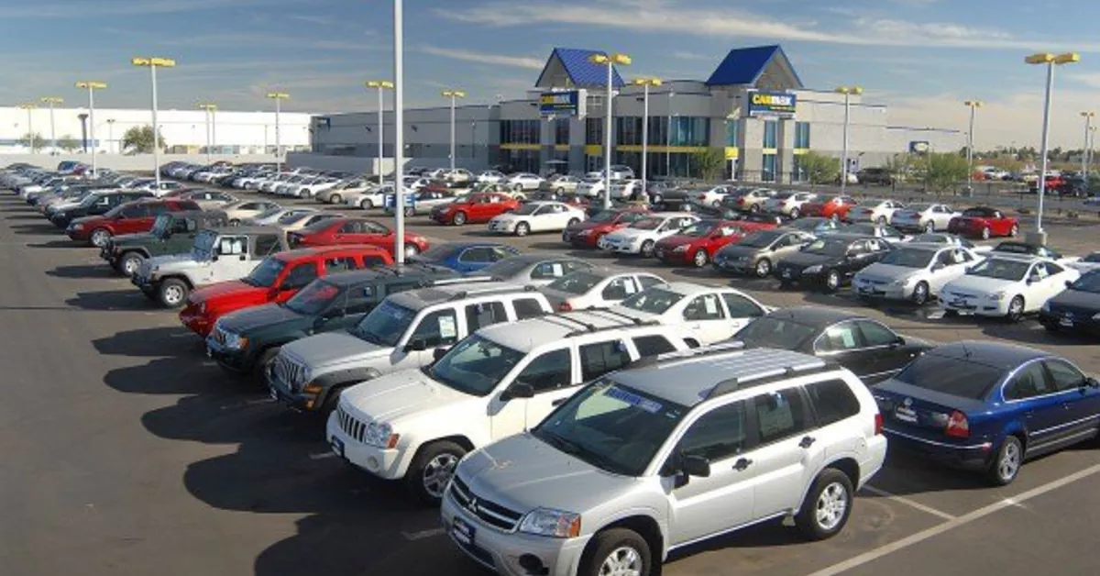
Introduction
+
Hypothesis
Ever since the COVID-19 Pandemic, used car prices shot up. New cars weren’t being built, so the ones that already existed were more desirable, and everyone knows how price and demand works. The less there is of something, the higher the price is. In particular, I noticed that Japanese cars especially rose in value, mainly Toyota and Honda, as did their affiliated Luxury brands, Lexus and Acura. For example, a high miled 2013 Lexus RX350 found off the internet was priced considerably higher than a comparable car, this once again, high miled 2014 GMC Acadia Denali.
This had me wondering, and later led to my research question; How exactly does the origin of brand effect pricing? Many people see Japanese vehicles as well built, reliable products, European vehicles as awesome from the start, awful later on, and American vehicles as unreliable, throwaway vehicles. Knowing what I wanted to research, I needed to figure out how to measure pricing amongst brands.
The method of getting an answer was simple: First, I needed to find a dataset of used cars for sale. After that was done, I need to see if the dataset already had a column for origin of country. If that wasn’t there, I’d need to make Japanese, American, and European brand groups by…. Grouping the brands from each country into one list. Once that was done, I could figure out the average price of each group - This will give us a general idea of how the origin of brand effects pricing
My hypothesis is that Japanese brands are going to have higher prices than their American counterparts, and possibly even more so than European cars.

Slide 3
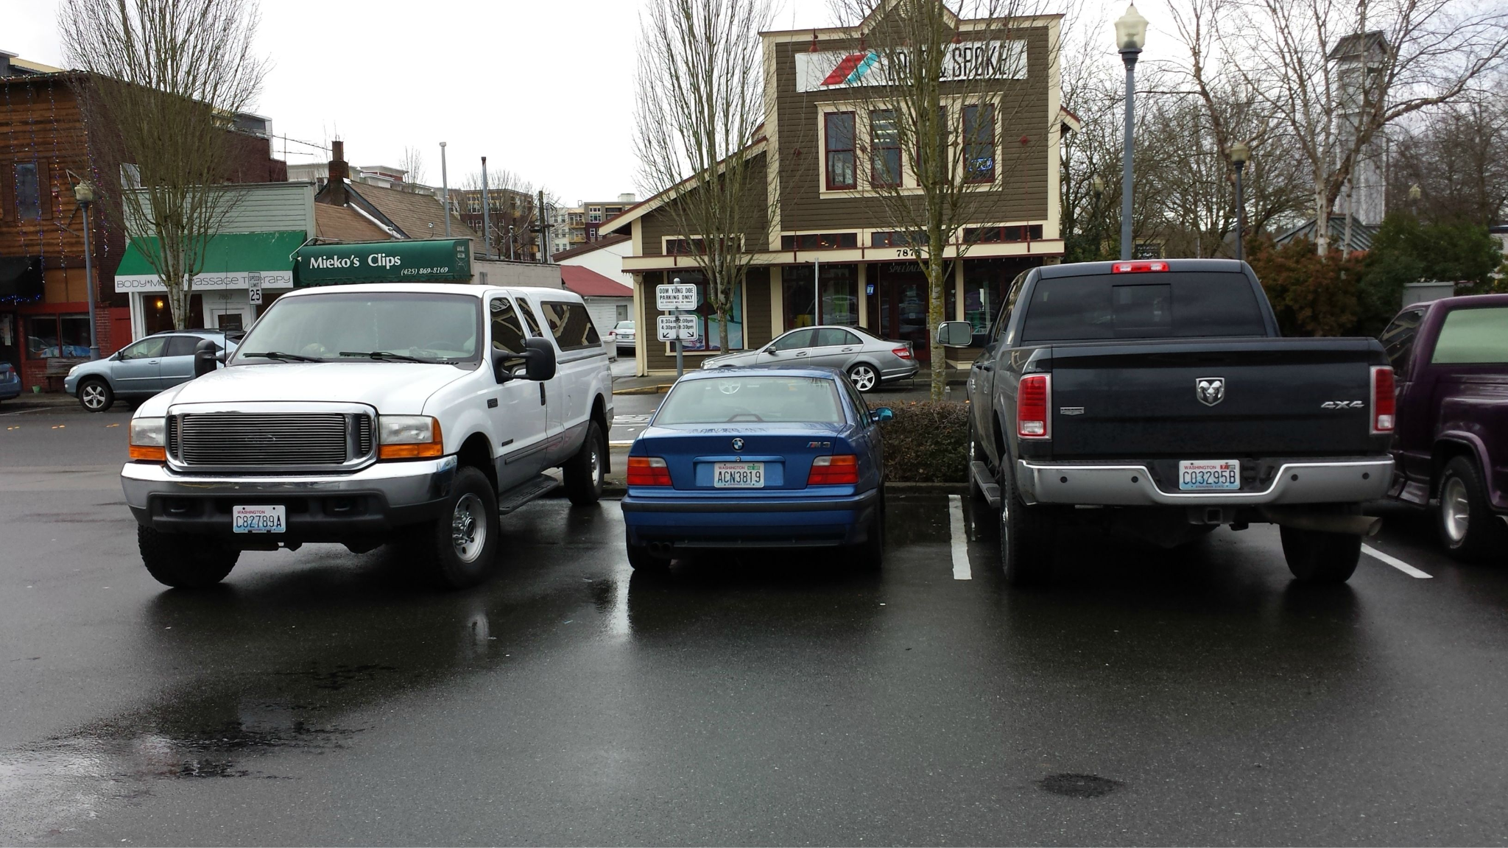
Background
To help explain the reason behind the chosen research question, I’d like to once again, bring attention to Japanese and American brands. Toyota, and by extension, Lexus, for example, are revered in the automotive industry for incredible reliability. Almost any time I saw a video of a failed Lexus or Toyota, most of the people were confident that the reason was owner’s negligence.
Unfortunately, American car companies, such as Chevrolet and Ford have their fans, but there is an considerably higher amount of people who think their vehicles are not nearly as well engineered. Pair that with a video like this one, and it’s clear where people are coming from with claim against American cars.
And lastly, while not my main focus, European cars are going to be a majority of used car datasets, so I need to take them into account. To put it short, I don’t imagine they’d be priced well. European cars, like American ones, have a negative stigma to some degree. They’re seen more as cars that while are well developed, are prone to failing, and when they fail, their repair costs are so high that nobody wants to keep them, and in turn, selling them cheap.
Pair this with the fact my family purchased two used vehicles (one german, one japanese) last year, and car prices and country origins have been in my head for awhile, and now with some knowledge on wrangling data, I figured it would be fun to figure it out.

Slide 4
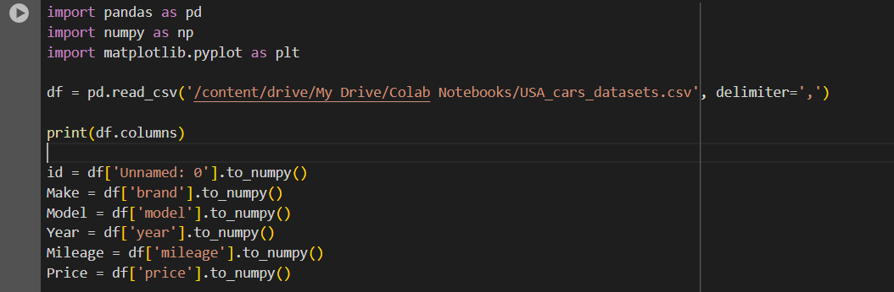
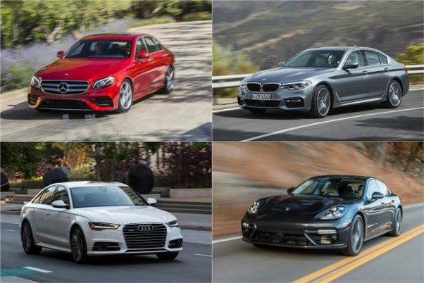
Step 1: Readying the Data
Data and Methods - Slide 1
The data was found off kaggle, it is a general used car dataset, consisting of used cars all across the United States, with all varying makes and models. After downloading the data and putting it into Google Colab, each column was converted to numpys. However, as there was no “id” column, I had to do it through a different method, pictured below.
Print(df.columns was used to make it easier to know what I needed to convert over. The main things needed, were Make/brand, year, milage, and price.

Slide 5
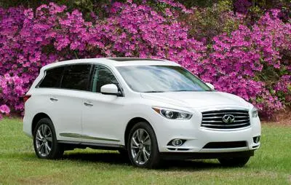

Step 2: Organization
Data and Methods - Slide 2
Now that the data was set up and ready to be used for testing, I needed to clean it up first in order to make sure I didn’t have any empty columns in any of the samples. A car going for 30 grand wouldn’t help me if I didn’t have the brand, and as a result, origin of the car, which is what I’m trying to look at. Fortunately, the data was already clean, and all 2499 samples had every column filled out - Sweet!
But, the data wasn’t ready to answer my question just yet. Tragically, while all samples had their columns all filled out, “country” was not a present column, so I had to group the brands by country manually. After checking all present brands, I then setup lists of Japanese, American, and European brands, which in turn, was used to group them into Japanese, American, and European cars. Now, if I typed (country here)_cars, the only data given to me would be cars from only those brands - Perfect!
This was also done for American and European cars

Slide 6
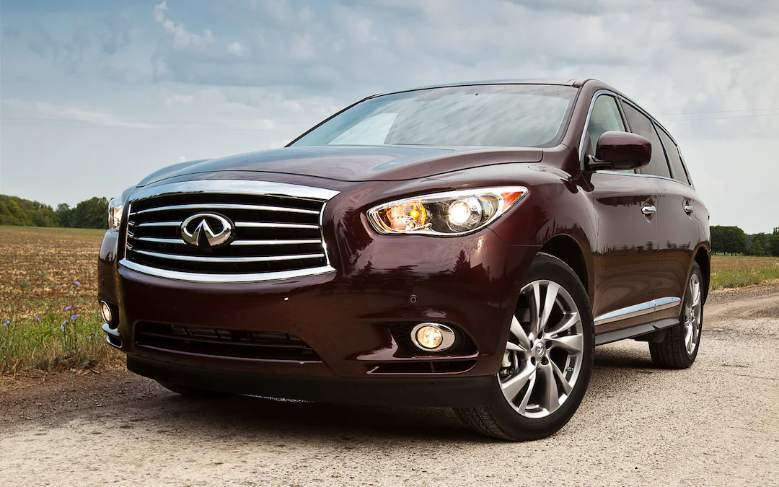
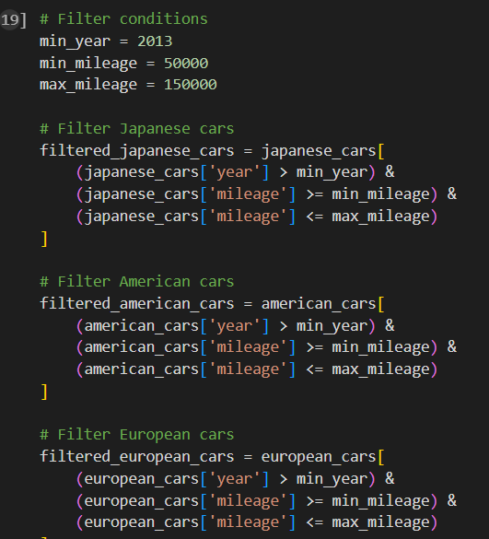
Step 2: Organization
(Continued)
Data and Methods - Slide 3
Of course, cars come from many different time periods, and have been used to varying degrees. If there was was a 1983 Toyota Corolla with 223,321 miles, and a 2018 Ford Fusion with 30,000 miles in the same data used to find an average price, country of origins wouldn’t matter - The average would be negatively skewed against the Japanese with that Corolla, so I had to put some parameters in place, shown below:
The minimum year was set to 2013.
A minimum mileage of 50,000 was set to ensure properly used vehicles were being used for the average calculation
To ensure vehicles too far gone weren’t also diluting the sample, a maximum mileage of 150,000 was set
Applied to Japanese, European, and American cars

Slide 7
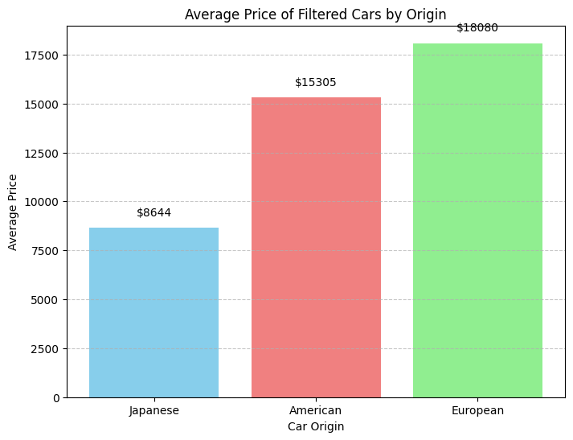
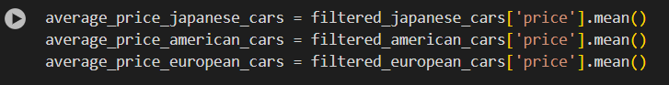
Step 3: Result Seeking
Data and Methods - Slide 4
Now that everything was set, to find an answer to my question, I needed to merely find the mean price from each of three filtered groups. Fortunately, Python has a way of doing that automatically. Once I found them, I plotted them on a graph, and got a massive hit to my hardwired thoughts - Japanese cars were the cheapest on average! Unsurprisingly, Americans weren’t the highest, the Euros were.

Slide 8
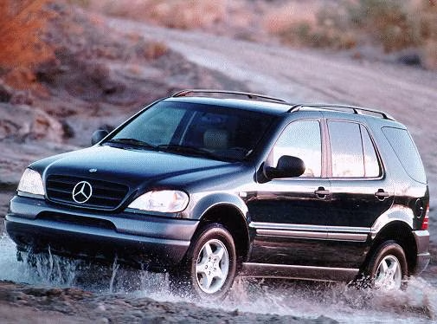
Workflow
Data was obtained from Kaggle
Data ported to Google Colab Notebook, and its columns converted to numpy's for analysis
Data cleaned (not needed ultimately)
Vehicle brands organized and grouped, by country of origin
Filters added in order to prevent too new, or too old of cars skewing results
Using filtered groups, mean prices were found to determine how certain origins of brands affected pricing
Flowing like the water flows around this car :D

Slide 9
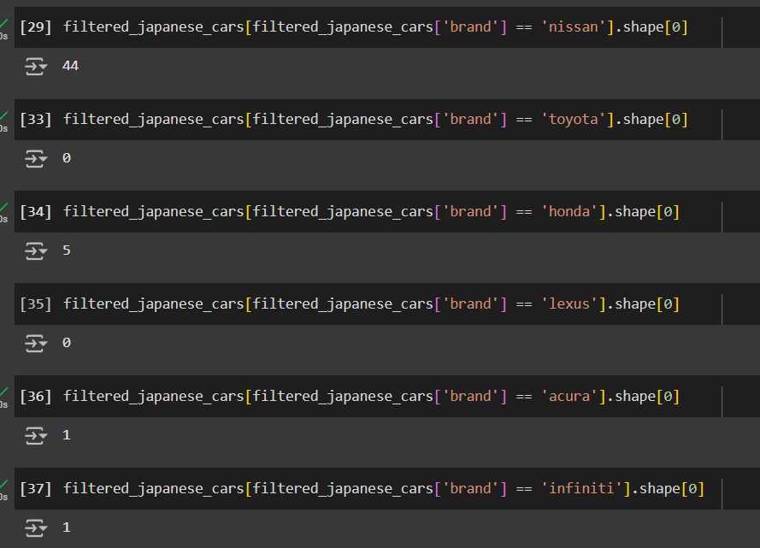
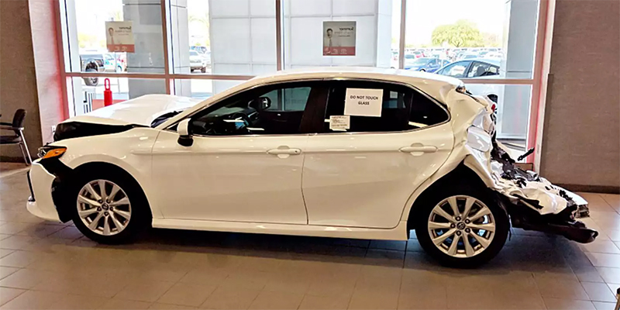
Result Explanation
I was simply dumbfounded by this. Toyotas, Hondas, and their luxury brands were priced higher than their US rivals consistently. For example, again This Lexus RX350 shown earlier in the the presentation outpriced not only that American GMC Acadia, but also this European Audi Q7 with almost 50% less miles than Lexus! But if that was the case, why were the Japanese cars the lowest priced?
Well, I decided to take a look at what brands primarily made up the “Japanese cars” group. Upon this, I made a shocking discovery: NONE of the Toyota and Lexus cars in the dataset met the filtered parameters, and only six total Acuras and Hondas were present. The Japanese cars used to find a mean price were mainly Nissan vehicles, which, unlike Toyotas and Hondas, don’t have that legendary reliability. Paired with the fact Nissan sells the cheapest brand new car in the United States, having them as essentially the only representative for Japanese cars severely skewed. I’d imagine if Toyotas and Hondas made up more of the Japanese sample size, the average price would go up considerably.

Slide 10
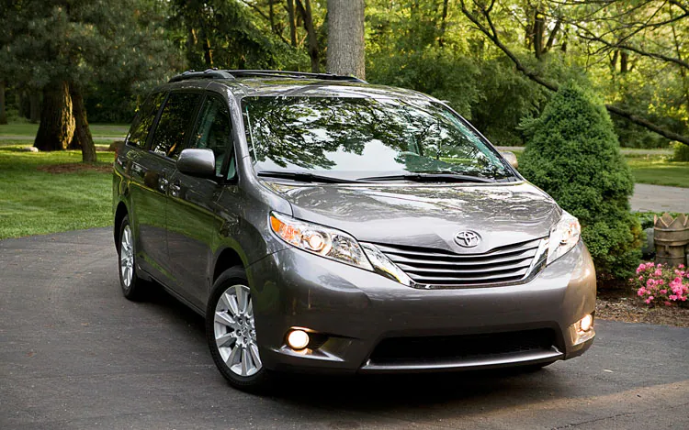
In Conclusion……..
My hypothesis, was proven wrong in an embarrassing fashion. The Japanese cars were not only shown to have been on average cheaper than American cars, but they were the on average the cheapest of the three groups. However, I do not believe this was a perfect analysis, as my samples lacked Japan’s two heaviest hitters; Toyota and Honda. This however, might still be a bump in Japan’s favor.
The absence of Toyotas and Hondas in this dataset means less of them for sale, perhaps due to their sublime reliability, their owners are less willing to part with them. My results showed me that it's more than the origin of brand that helps with the price - It’s the brand itself that elevates their prices based on their reputation. Nissan, the primary brand in my Japanese sample, doesn’t have the reputation of Toyota and Honda, and the lower average pricing shows this. In future, if I plan to do this again, I must make sure the dataset I use consists of a major variety of brands, or maybe I need to broaden my filters to allow more cars in, cars that might be Toyotas and Hondas that’ll help the average price of Japanese cars rise.

